Slide 1
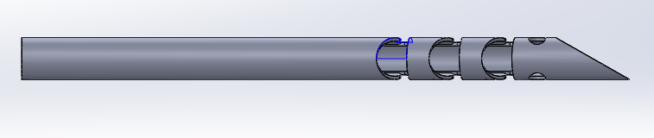
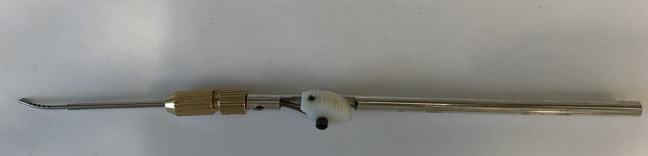
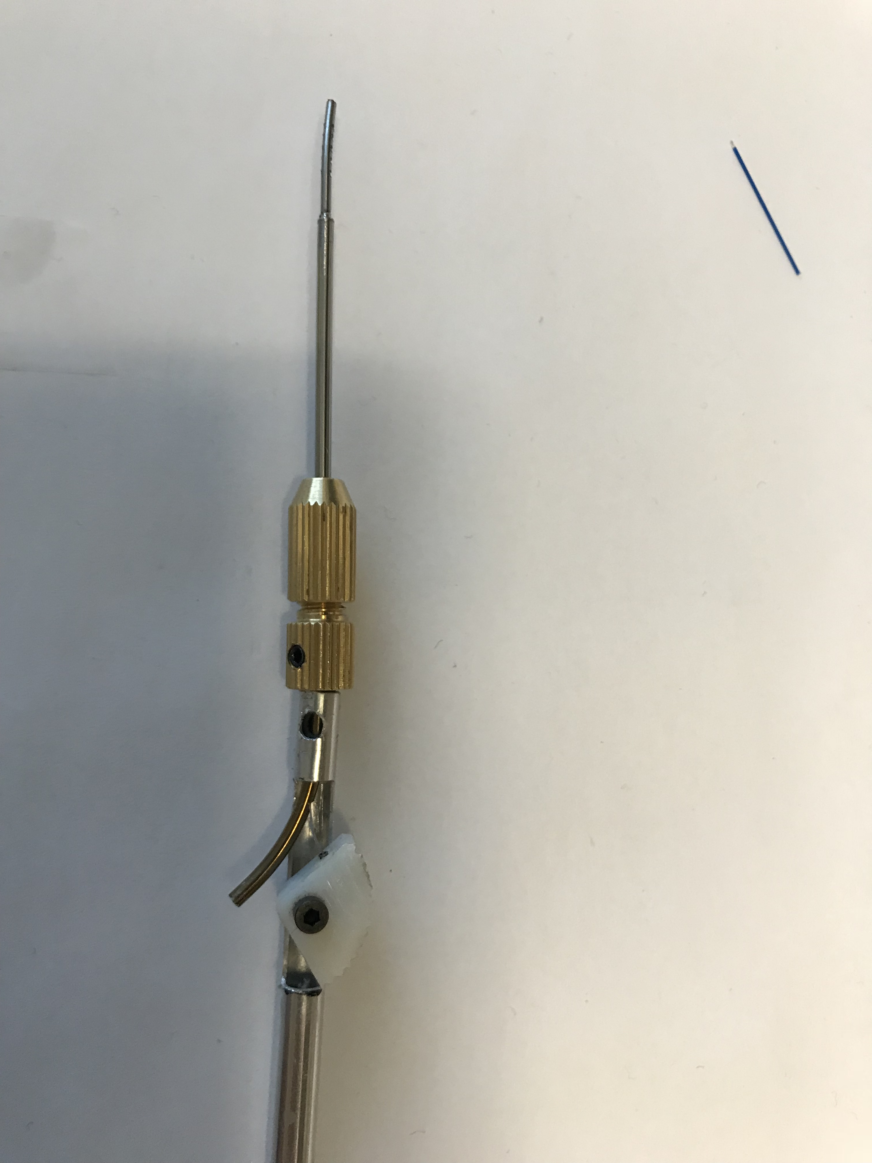
A: wrist + shaft
Medical grade NiTi (need certificate of conformance)
Medical grade laser cutting – outsourced
Shaft length = tip to collet
Wrist: 80º, 135º
Weld the stopper before the collet
B: Collet + handle
Brass collet + handle – laser welded – might have to get this part metal 3D printed with certificate of conformance
Mill lines along the shaft for easier grip
C: Cable
Order biocompatible cable (with certificate) – current cable could be coated
Also don’t know if stainless steel wire has a coating
Changed the way the cable is attached – will have 2 holes at the tip
D: Finger Piece
metal 3D print medical grade
Screws can be cleaned and sterilized
D
A
B
C
E: attachment to suction
Add luer lock to this
Shape set NiTi medical grade
E
Notes:
Then, need to create a ‘sterile zone’ in lab where
New materials to order:
3D printed metal components:

